Slide 1
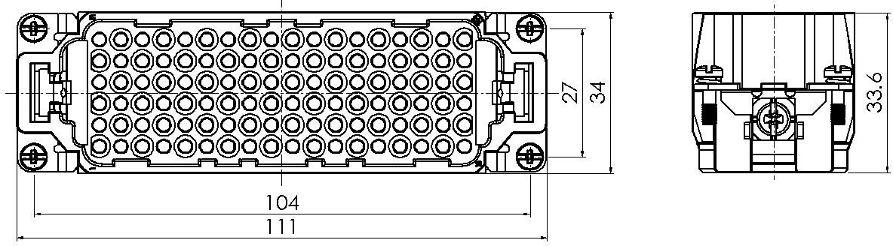
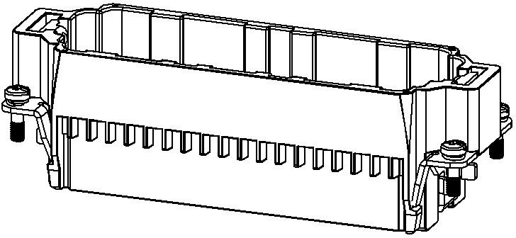
HDD Series, Crimp Connection, 108 pin, Male insert
Typecode ID
HDD-108-MC
1 007 03 0000089
技术数据
Features
Product Properties
High quality engineering plastics
Series HDD
Crimp termination
Mating with H24B
≥500 Mating cycles
Connection mode Crimp termination
Approval: CE
Gender Male
RoHS-compliant
Rated voltage 250 V
Rated current 10 A
Rated impulse voltage 4 kV
Mating contact 10A (DSM/DGM)
Number of pins 108
Core cross-section/Clamping abilit 0.14~ 2.5 mm²/AWG26 ~ AWG14
Grounding conductor Yes
Pollution degree 3
Insulation resistance ≥10¹⁰ Ω
Limiting temperature -40 ℃ ~ +125 ℃
Standard EN 60664-1, IEC 61984
Insert
Material PC
Colour RAL 7032
Commercial data
Weight 0.069 kg
Packaging unit 1 pc
Country of origin CN
*这里所列的是设计数据，有关产品的变更不在此做说明，未尽事宜请联系客服。用户有责任验证功能、符合适用的法律和指令以及在特定应用中的电气安全
。
Beisit Electric Tech (Hangzhou) Co., Ltd. ▮Tel:+86-571-8936 2888 ▮Fax:+86-571-8936 2999 ▮E-mail:info@beisit.com ▮Http://www.beisit.com

Slide 2
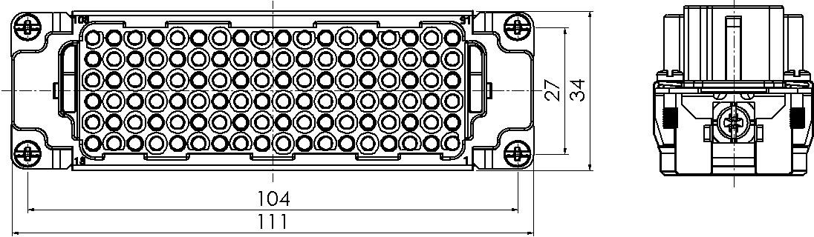
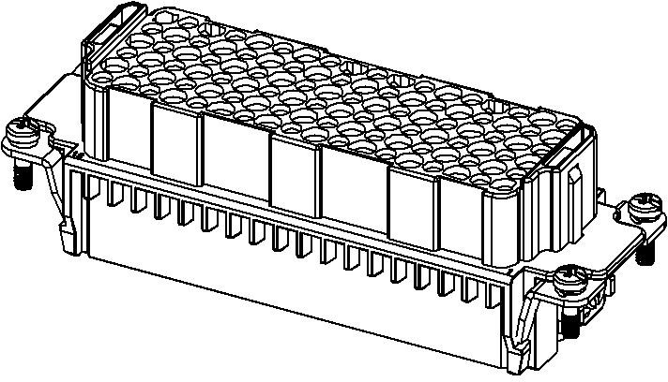
HDD Series, Crimp Connection, 108 pin, Femle insert
Typecode ID
HDD-108-FC
1 007 03 0000090
Technical Data
Features
Product Properties
High quality engineering plastics
Series HDD
Crimp termination
Mating with H24B
≥500 Mating cycles
Connection mode Crimp termination
Approval: CE
Gender Femle
RoHS-compliant
Rated voltage 250 V
Rated current 10 A
Rated impulse voltage 4 kV
Mating contact 10A (DSF/DGF)
Number of pins 108
Core cross-section/Clamping ability 0.14~ 2.5 mm²/AWG26 ~ AWG14
Grounding conductor Yes
Pollution degree 3
Insulation resistance ≥10¹⁰ Ω
Limiting temperature -40 ℃ ~ +125 ℃
Standard EN 60664-1, IEC 61984
Insert
Material PC
Colour RAL 7032
Commercial data
Weight 0.075 kg
Packaging unit 1 pc
Country of origin CN
*这里所列的是设计数据，有关产品的变更不在此做说明，未尽事宜请联系客服。用户有责任验证功能、符合适用的法律和指令以及在特定应用中的电气安全。
Beisit Electric Tech (Hangzhou) Co., Ltd. ▮Tel:+86-571-8936 2888 ▮Fax:+86-571-8936 2999 ▮E-mail:info@beisit.com ▮Http://www.beisit.com

